Slide 1
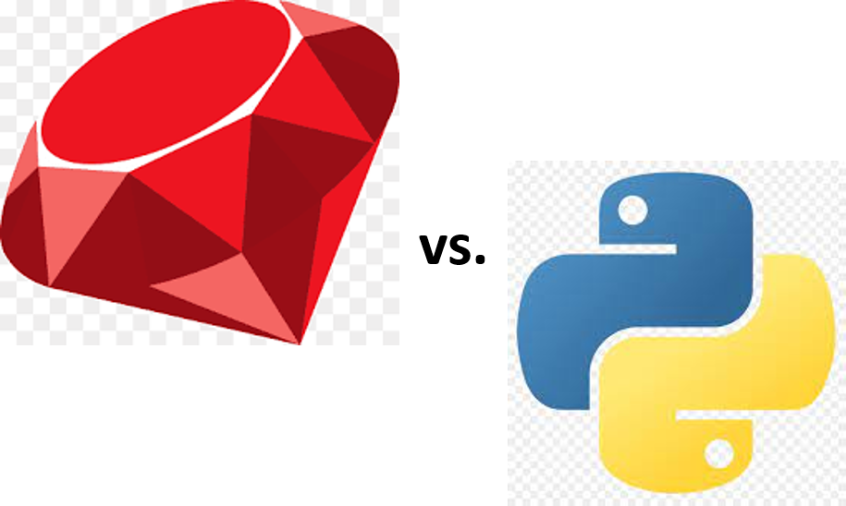
Recommendation of Comparative Linguistics
-Learn Identity of Programming Language from Ruby vs. Python-
Composed By: Hayato Ishida
For Japanese version, click here
Updated On: 31 March 2025

Slide 2

About Me
Accounts
GitHub: @hayat01sh1da
X: @hayat01sh1da
LinkedIn: @hayat01sh1da
Speaker Deck: @hayat01sh1da
Docswell: @hayat01sh1da
Occupation: Software Engineer
Things I Am Into
Linguistics
Singing at Karaoke
Listening to Music
Watching Movies
Cat Feeding

Slide 3
Licences / Certifications
English
TOEIC® Listening & Reading 915: Certified on December 2019
Engineering
Information Security Management: Certified on November 2017
Applied Information Technology Engineer: Certified on June 2017
Fundamental Information Technology Engineer: Certified on November 2016
IT Passport: Certified on April 2016
Others
Abacus 2nd Class: Certified on June 2002
Mental Arithmetic 3rd Class: Certified on February 2001

Slide 4
Skill Stack
Languages
Japanese: Native Proficiency
English: Full professional Proficiency
Development
Backend: Ruby(Ruby on Rails), Python
Frontend: TypeScript + React.js, TypeScript +Vue.js
Database: MySQL, PostgreSQL, MongoDB
Architecture: Monolith, Modular Monolith
Hosting: AWS ESK
Versioning: Git, GitHub
CI/CD: GitHub Actions, ArgoCD
Monitoring: Datadog, Sentry

Slide 5
Work Histories
Period | Genre | Position | Jobs
Aug 2021 - Present | Saas(Educational Service) | Software Engineer | Backend Development Frontend Development CI/CD Maintenance Weekly Release Manager Troubleshooting Documentation Technical Debt Resolution Tech Blog Entries LT Speaker
Feb 2020 - Dec 2020 | SaaS(Chatbot Platform) | Backend Engineer | Backend Development Documentation Technical Debt Resolution Inspection of Alternative API

Slide 6
Work Histories
Period | Genre | Position | Jobs
Jun 2018 - Jan 2020 | Contract-basis Developer | Software Engineer | Backend Development Frontend Development Troubleshooting Quality Assurance Tech Blog Entries
Apr 2016 - Jan 2018 | System Engineering Service | System Engineer | Corporate Account Admin Windows Server Maintenance Security Admin Assistant Internationalisation / Localisation

Slide 7
International-Exchange Activities
Activities in University
English Linguistics Seminar(Focusing on Mass Media English)
International-Exchange Clubs(The 2nd Year)
International-Exchange Programmes conducted by Japan Cabinet Office(2013 - 2016)
Japanese Linguistics Course(The Final Year)
Overseas Life Experience
Working Holiday in Australia(April 2014 - March 2015)
Language School for 1 month in Sydney
Work for 6 Months in Hamilton Island Resort
Volunteering for 1 Month as Assistant Teacher of Japanese Language at St Ives High School in NSW
Other Activities
Keep Everyday Journal in English (April 2014 - Present)
Sunrise Toastmasters Club(February 2017 - March 2018)
Vital Japan(January 2018 - July 2019, October 2022 - February 2023)
Self Learning and Training of English Language
Participation Ruby-Related Tech Conferences

Slide 8
Agenda
The Object of Comparative Linguistics
3 Common Features between Ruby and Python
3 Different Features between Ruby and Python
Epilogue
References

Slide 9
1. The Object of Comparative Linguistics

Slide 10
1. The Object of Comparative Linguistics
I majored in English linguistics in university.
The biggest lesson was that comparison of one with another gives us insight into the essence of an object.
The following saying vividly represents it.
"He who knows no foreign language knows nothing of his mother tongue." by Johann Wolfgang von Goethe, the greatest writer in the Germanic language.

Slide 11
1. The Object of Comparative Linguistics
As for natural languages, we are forced to be aware of the differences between the mother tongue and another language when we command any in learning, life, and at work, which provides us with deep insight into the identity of us and our language.
※ For the details, refer to Dive Deeper into Present-Day English Vol.5 -Hidden Feature of Language-.

Slide 12
1. The Object of Comparative Linguistics
Regarding programming languages, Mr. Anders Norås mentions almost the same experience on 97 Things Every Programmer Should Know > 27. Don't Just Learn the Language, Understand its Culture.
In their seminal book, The Pragmatic Programmer, Andy Hunt and Dave Thomas encourage us to learn a new programming language every year. I've tried to live by their advice and throughout the years I've had the experience of programming in many languages. My most important lesson from my polyglot adventures is that it takes more than just learning the syntax to learn a language: You need to understand its culture.

Slide 13
1. The Object of Comparative Linguistics
Nowadays, width and depth of responsibility of software engineers gets so greater that we cannot help feeling like being able to command multiple numbers of programming language is the de facto standard, as it were.
Such requirement supplies more deep understanding of the first acquired language than skillset itself.
LT physically restricts the upper limit of allocated time, so I focus on pulling a trigger of awareness of what Ruby is, my (and audience's) main programming language.

Slide 14
2. 3 Common Features between Ruby and Python

Slide 15
2. 3 Common Features between Ruby and Python
Ruby and Python share the following 3 features.
Object-Oriented
Dynamic Typing
Values Developer's Experience

Slide 16
2. 3 Common Features between Ruby and Python
① Object-Oriented
There are the following 3 principles.
Inheritance: Subclass takes over abstract methods and attributes from the base class. Subclass inherits shared nature of the base class, which allows developers to implement only the differences. Thanks to this principle, codes are so reusable that developers can program in an efficient way.
Polymorphism: Behaviour differs from receiver to receiver even if the name of the called method is the same (e.g., Doctor#practice means starting a medical business, whereas Athlete#practice performing again and again in order to acquire a specific physical skill).
Encapsulation: The design that developers can be concerned only about the outer behaviours by communication of messages between receivers, method calls and accesses to attributes, with the inner detailed data processing and sustained data hidden. It prevents deep dependencies on the inner processes at the level of requirements, which makes sure of maintainability.

Slide 17
2. 3 Common Features between Ruby and Python
② Dynamic Typing
If the data type is determined during compilation in static typing while it is fixed at runtime in dynamic typing.
C, Java and TypeScript belong to the former, and Ruby, Python, JavaScript and PHP the latter.
In dynamic typing such as Ruby and Python, developers are not allowed to interfere in typing so that what data is sustained in the variable stays unknown till the execution.
That is why understandable naming of variables at the first sight is highly important particularly in those languages.
Mr. Yukihiro Matsumoto, called Matz and the creator of Ruby, mentions the fact that appropriate naming reflects the corresponding appropriate design in 97 Things Every Programmer Should Know > 107. The Importance of Naming, Japanese edition.

Slide 18
2. 3 Common Features between Ruby and Python
③ Values Developer's Experience
Ruby and Python provide developers with wonderful coding experiences via ease of execution and dynamic programming(e.g., `eval` and `Module#class_eval`).
Even roughly written program runs most of time, so the developer who has poor skills, experience and understanding is highly likely to undergo bad readability and hardship of tough debugging, not just by themselves but those concerned.
Carefully design the system based on the requirements, implement necessary classes and methods with the least scope of responsibility.
You must be sure how important testing codes are if you are following what the state above means.

Slide 19
3. 3 Different Features between Ruby and Python

Slide 20
3. 3 Different Features between Ruby and Python
Ruby and Python have the following 3 differences.
Presence of Concept of Private Field
The Way to Cache Return Value via Delayed Evaluation
Receiver and Argument

Slide 21
3. 3 Different Features between Ruby and Python
① Presence of Concept of Private Field
Ruby allows developers to define the private field with `private` keyword.
In contrast, Python has no concept of private field itself.

Slide 22
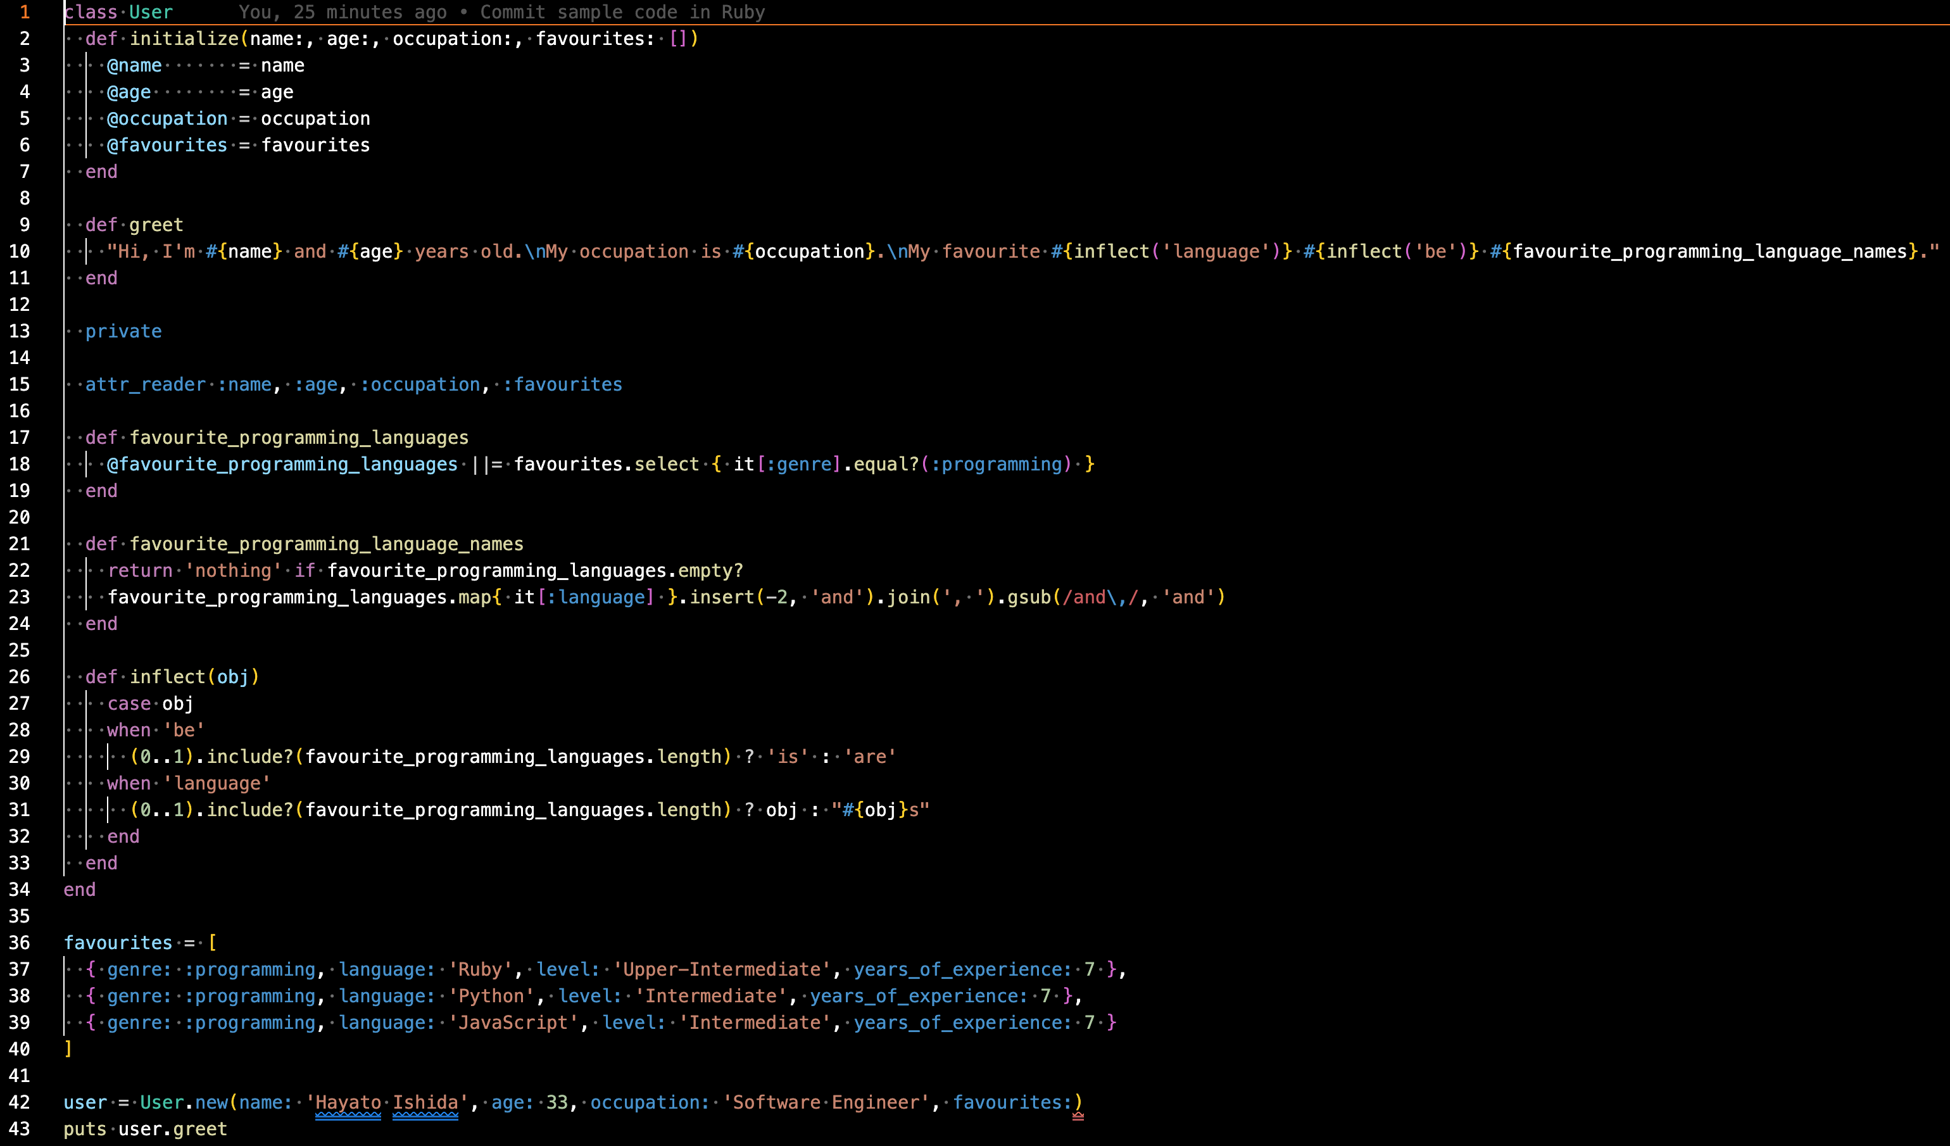
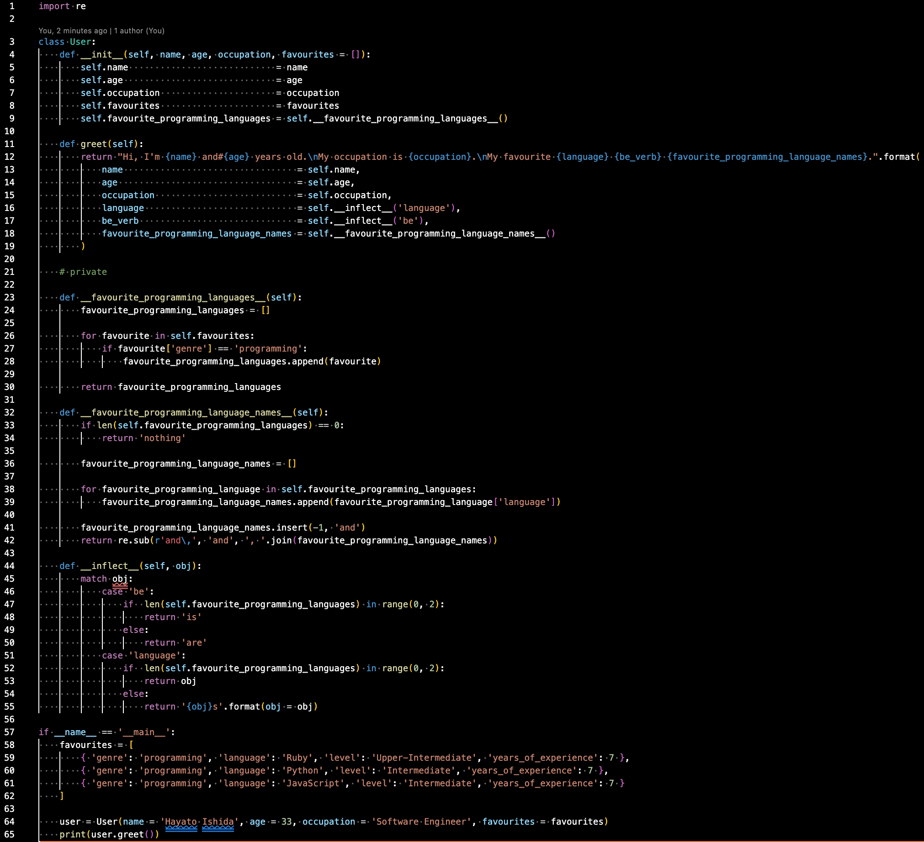
3. 3 Different Features between Ruby and Python
① Presence of Concept of Private Field

Slide 23
3. 3 Different Features between Ruby and Python
① Presence of Concept of Private Field
As mentioned in 2. 3 Common Features between Ruby and Python > ① Object-Oriented > 3. Encapsulation, Object-Oriented programming languages normally have system which conceal the detailed inner data processing and sustained data, but Python does not.
This allows method calls and override of data even outside of the class with their definition, which is terribly vulnerable to security risks and bugs.
Also, `def _method` and `def __method__` implicitly enables developers to tell public methods from private ones; however, it is not guaranteed by the Python's paradigm, so this means is not safe at all.
What is worse, methods provided by libraries often start with `_`, so the way shown above can unexpectedly override the library method.
This is reported on X and Quora as far as I observed.

Slide 24
3. 3 Different Features between Ruby and Python
② The Way to Cache Return Value via Delayed Evaluation
What symbols are available totally depends on the programming language.
`||` is one of the familiar examples.
Ruby utilises this symbol for memoization, caching in other words.
On the contrary, `||` is not available in Python, so it does not provide memoization in a method definitions via delayed evaluation as Ruby does.
Python is likely to allow us only to cache data by assignment of a return value of a method to a instance variable as show on the next slide.

Slide 25
3. 3 Different Features between Ruby and Python
② The Way to Cache Return Value via Delayed Evaluation

Slide 26
3. 3 Different Features between Ruby and Python
③ Receiver and Argument
I often get confused in which is receiver or argument when I code use some methods which has the same names and purposes in Ruby and Python in turns.
Array#join in Ruby and String#join in Python represent it.
Array#join in Ruby: Receiver is the target elements in an array and argument is the delimiter.
String#join in Python: Receiver is the delimiter in an array and argument is the target elements.

Slide 27
3. 3 Different Features between Ruby and Python
③ Receiver and Argument

Slide 28
3. 3 Different Features between Ruby and Python
③ Receiver and Argument
They are interpreted as follows each.
`Array#join` in Ruby: The target elements join together with the delimiter you provide.
`String#join` in Python: The delimiter you provide joins the target element together.
In English, given information already shared between the provider and the receiver is placed forward and new information not shared yet is backward.
This rule is called the End-Focus principle.
That it to say, the information to be emphasise is placed at the end of the sentence.

Slide 29
3. 3 Different Features between Ruby and Python
③ Receiver and Argument
In the sense, when generating a string from the elements of an array, Ruby is interested in delimiter and Python is in the elements of an array to join together.
In terms of a developer's experience, it is more preferable to put the elements of an array first and the delimiter last, which enables us to make sense what joins together with what.
The difficulty in acquiring the second or a foreign language totally depends on what the mother tongue is just like natural languages, so I expressed it 'personal opinion'.
However, I am quite sure that Ruby gives us a lot closer writing experience to English of the natural languages as a person who majored in English linguistics than Python Does.

Slide 30
5. Epilogue

Slide 31
5. Epilogue
Did I succeed in pulling a trigger to make you all aware of what features and natures Ruby, your languages, has by comparison with Python for the past 5 minutes.
97 Things Every Programmer Should Know > 43. Know Well More than Two Programming Languages suggests that we should learn other languages which have different paradigms.
To compare it to natural languages, it is similar for me, a native Japanese language speaker, to learn English, one of the Germanic languages. (Refer to Dive Deeper into Present-Day English Vol.1 -What English Is- > 2. Relation between Language Families and Learning Costs to make sure what I mean).
There are loads of differences between them in terms of grammar, vocabulary and collocation.
The same thing applies to programming languages.

Slide 32
5. Epilogue
It may not be a programming language, but I often compose workflows of GitHub Actions in Shell Script.
It always turns out that writing it just like as Ruby is impossible with Object-Oriented philosophy.
It says, "Don't use array too much and focus on integrate simple procedures."
This is because of the difference in paradigm.
I have not commanded Data-Oriented languages such as Go Lang and Rust; however, I would pick them up in the same topic once I acquire them.
If you know much about them, would you please share your thought via comparative linguistics?

Slide 33
6. References

Slide 34
6. References
97 Things Every Programmer Should Know
Last Accessed On: 10 February 2025
He who knows no foreign language knows nothing of his mother tongue - La Academia Language School
Last Accessed On: 10 February 2025
object-oriented programming (OOP)
Last Accessed On: 10 February 2025
Compiler vs. Interpreter: 12 Critical Differences To Know
Last Accessed On: 10 February 2025

Slide 35
EOD

